Slide 1
計算機概論實習 -- POINTER
TA name | email
張竣傑 | spaw06j0.c@nycu.edu.tw
洪偉捷 | rogerweijie.cs10@nycu.edu.tw
陳俊凱 | jyunkaichen.cs10@nycu.edu.tw
蔡宜庭 | tsai.cs09@nycu.edu.tw
原瑄 | yuan040686.cs10@nycu.edu.tw
賴欣儀 | laisy.ee10@nycu.edu.tw
洪湘惠 | sofina604.cs10@nycu.edu.tw
Week 12 (2021/12/07)

Slide 2
Homework1
We use 2 arrays A and B to store book titles in the library.
Each element of the array holds one book title. We will write a main() program to add, delete, or exchange elements of A and B repeatedly.
main() first reads 2 positive integers, m and n.
main() dynamically allocates an array of m elements. Each element is a pointer to a char array. This is the A array.
main() dynamically allocates an array of n elements. Each element is a pointer to a char array. This is the B array.

Slide 3
Homework1 (Operation1)
main() then reads a integer p (p=0, 1, or 2) to choose your operation.
p=0 is for adding a book.
First read 3 integer x, y, and s.
x should be 0 or 1 to choose array A or B.
y is the index of the array and it should be empty, otherwise stop this operation. If y is out of bound should stop too.
s is the size of your book title ready to input.
If this operation doesn’t stop, then dynamically allocate a char array with size s, and input the string.
Then store the string to the chosen index of the chosen array.

Slide 4
Homework1 (Operation2)
main() then reads a integer p (p=0, 1, or 2) to choose your operation.
p=1 is for deleting a book.
First read 2 integer x and y.
x should be 0 or 1 to choose array A or B.
y is the index of the array. If y is out of bound, stop this operation.
Then delete the string in the chosen index of the chosen array.

Slide 5
Homework1 (Operation3)
main() then reads a integer p (p=0, 1, or 2) to choose your operation.
p=2 is for exchanging a book.
First read 2 integer x and y.
x is the index of the array A.
y is the index of the array B.
Either x or y is out of bound should stop this operation.
Then exchange 2 chosen strings.

Slide 6
Homework1 (cont.)
After every operation, you should print out every book titles in array A and B.
You don’t need to set the exit condition. That is, you can use while(1) loop to do operations eternally.

Slide 7
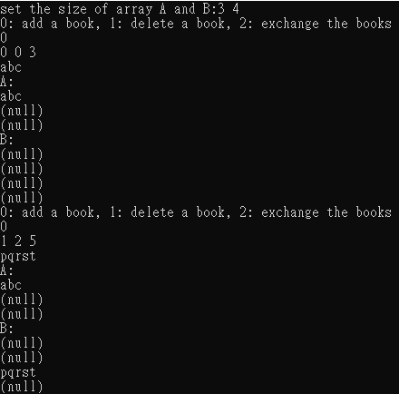
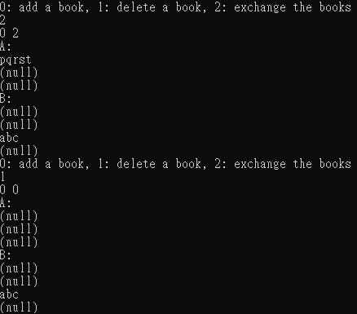
Homework1 Sample
3 5
0
0 2 6
asdfg

Slide 8
Homework2 Function Pointer
The program should consume a list of command and execute at once, instead of executing once receiving single command.
Your program should use the function with the exactly same function signature below
Program Execution Step:
Enter 0 or 1 to determine whether to quit or not
Enter list of command
For each line, the first is decimal number the second is operator code
Note that you should write your own add, sub, mul, div function in order to to store those function to array of function pointer which is the parameter of “callback_execution”.
Operator code are (+,-,*,/,q), note that q means end of command.
Execute the command by using “callback_execution“ function and show the reuslt
Back to step1

Slide 9
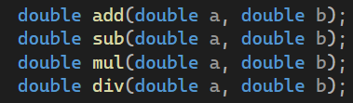
Homework2 Function Pointer
Note
Your program should use the function which has exactly the same function signature as below
Your program output should have exactly the same output as the sample provided in next slide.
You should implement your own add(addition), sub(subtraction), mul(multiplication), div(divide), function.
For argument ”num_of_callback”, it means the number of function to execute which is also “the length of callback pointer”.
“the length of callback pointer” + 1 = “the length of double pointer”

Slide 10
Homework2 Function Pointer-Detail
double* params
20 | 2 | 4 | 100 | 20 | 1000
double(**callbacks)(double, double)
* | * | / | + | -
int num_of_callback
5

Slide 11
Homework2 Function Pointer-Detail
double* params
20 | 2 | 4 | 100 | 20 | 1000
double(**callbacks)(double, double)
* | * | / | + | - | q
Execution Step
20 * 2 = 40
40 * 4 = 160
160 /100=1.6
1.6+20=21.6
21.6-1000=-978.6

Slide 12
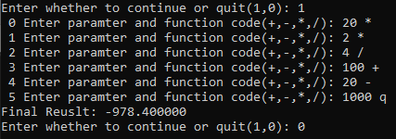
Homework2 Function Pointer
20 * 2 *4 / 100 + 20 – 1000 = -978.4
Note that the calculation above are calculated in order.

